Slide 1
HTML
ULP

Slide 2
HTML
HTML stands for Hyper Text Markup Language
HTML is the standard markup language for creating Web pages
HTML describes the structure of a Web page
HTML consists of a series of elements
HTML elements tell the browser how to display the content
HTML elements label pieces of content such as "this is a heading", "this is a paragraph", "this is a link", etc.

Slide 3
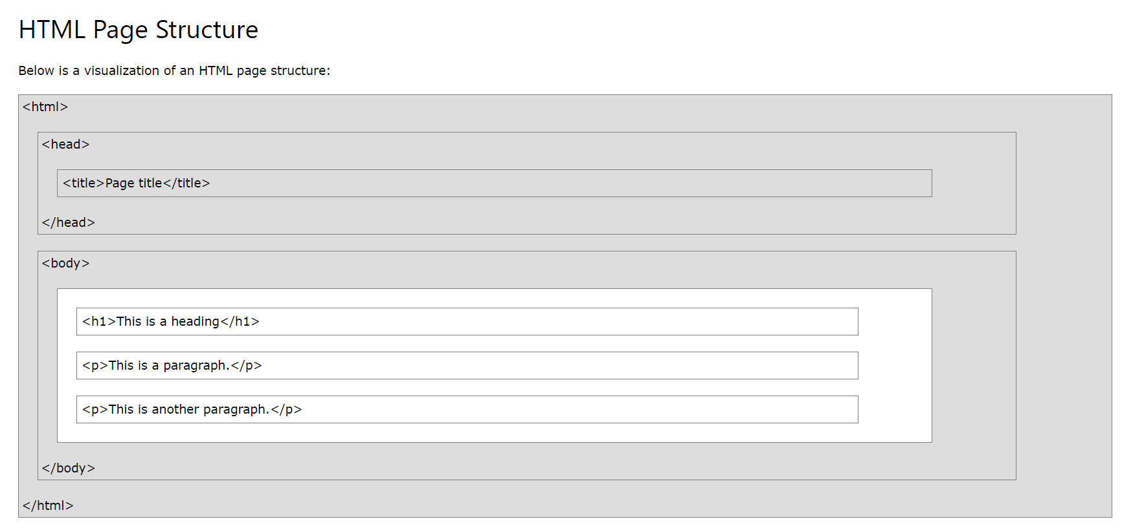

Slide 4
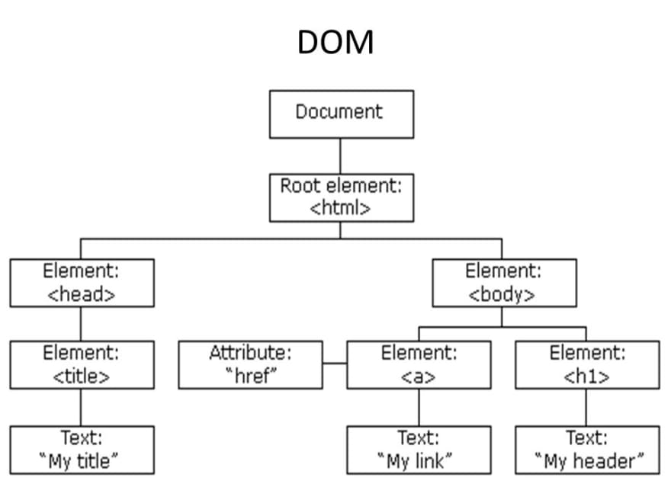
When a web page is loaded, the browser creates a Document Object Model of the page.

Slide 5
HTML Standard
<!DOCTYPE html> <html> <head> <title>Page Title</title> </head> <body> <h1>This is a Heading</h1> <p>This is a paragraph.</p> </body> </html>

Slide 6
Head
<h1>Heading 1</h1> <h2>Heading 2</h2> <h3>Heading 3</h3> <h4>Heading 4</h4> <h5>Heading 5</h5> <h6>Heading 6</h6>

Slide 7
Paragraph
<p>This is a paragraph.</p> <p>This is another paragraph.</p>

Slide 8
Text Formatting
<b> - Bold text
<strong> - Important text
<i> - Italic text
<em> - Emphasized text
<mark> - Marked text
<small> - Smaller text
<del> - Deleted text
<ins> - Inserted text
<sub> - Subscript text
<sup> - Superscript text

Slide 9
Address
<address> Written by John Doe.<br> Visit us at:<br> Example.com<br> Box 564, Disneyland<br> USA </address>

Slide 10
Cite
<p><cite>The Scream</cite> by Edvard Munch. Painted in 1893.</p>

Slide 11
Bi-Directional Override
<bdo dir="rtl">This text will be written from right to left</bdo>

Slide 12
Comments
<!-- Write your comments here -->
<!-- Do not display this image at the moment <img border="0" src="pic_trulli.jpg" alt="Trulli"> -->

Slide 13
Image - REVISAR
<img src="img_chania.jpg" alt="Flowers in Chania">
<img src="img_girl.jpg" alt="Girl in a jacket" width="500" height="600">
<img src="/images/html5.gif" alt="HTML5 Icon” title=“Image”>

Slide 14
Favicon
<link rel="icon" href="img/feup_vP5_icon.ico"> https://icoconvert.com/

Slide 15
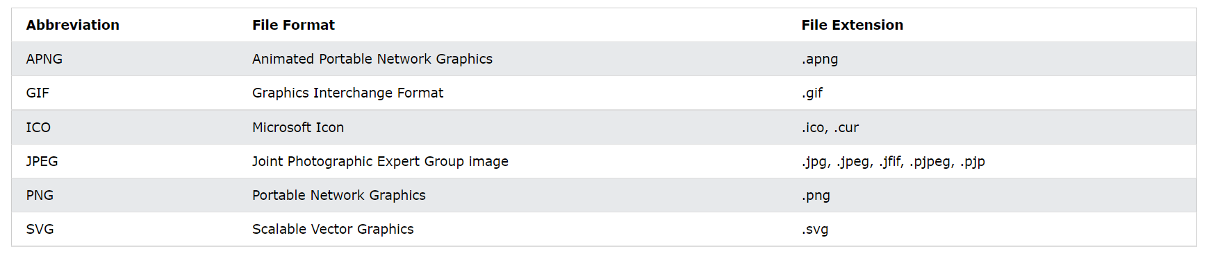

Slide 16
Links – PAREI AQUI
<a href="https://www.w3schools.com/">Visit W3Schools.com!</a>
<a href="https://www.w3schools.com/" target="_blank">Visit W3Schools!</a>

Slide 17
Access Keys
<a href="https://www.w3schools.com/html/" accesskey="h">HTML tutorial</a><br>
<a href="https://www.w3schools.com/css/" accesskey="c">CSS tutorial</a>
Edge, IE, Chrome, Safari, Opera 15+: [ALT] + accesskey
Opera prior version 15: [SHIFT] [ESC] accesskey
Firefox: [ALT] [SHIFT] + accesskey

Slide 18
Tip
VSCODE: New File, save HTML
Para carregar o template, apenas digite ! e escolha o template.

Slide 19
Image Maps https://www.image-map.net/
<img src="workplace.jpg" alt="Workplace" usemap="#workmap"> <map name="workmap"> <area shape="rect" coords="34,44,270,350" alt="Computer" href="computer.htm"> <area shape="rect" coords="290,172,333,250" alt="Phone" href="phone.htm"> <area shape="circle" coords="337,300,44" alt="Coffee" href="coffee.htm"> </map>

Slide 20
Table – td (table cell) e tr (table row)
<table> <tr> <td>Emil</td> <td>Tobias</td> <td>Linus</td> </tr> <tr> <td>16</td> <td>14</td> <td>10</td> </tr> </table>

Slide 21
colspan
<table> <tr> <th colspan="2">Name</th> <th>Age</th> </tr> <tr> <td>Jill</td> <td>Smith</td> <td>43</td> </tr> <tr> <td>Eve</td> <td>Jackson</td> <td>57</td> </tr> </table>

Slide 22
rowspan
<table> <tr> <th>Name</th> <td>Jill</td> </tr> <tr> <th rowspan="2">Phone</th> <td>555-1234</td> </tr> <tr> <td>555-8745</td> </tr> </table>

Slide 23
List
<ul> <li>Coffee</li> <li>Tea</li> <li>Milk</li> </ul>

Slide 24
Ordered List
<ol> <li>Coffee</li> <li>Tea</li> <li>Milk</li> </ol>

Slide 25
Ordered List
<ol type="1"> <li>Coffee</li> <li>Tea</li> <li>Milk</li> </ol>
<ol type="A">
<ol type="a">
<ol type="I">
<ol type="i">
<ol start="50">

Slide 26
Description list
<dl> <dt>Coffee</dt> <dd>- black hot drink</dd> <dt>Milk</dt> <dd>- white cold drink</dd> </dl>

Slide 27
DIV e SPAN (div é container para outros elementos html não inline e span é inline)
<!DOCTYPE html>
<html>
<body>
<h1>The span element</h1>
<p>My mother has <span style="color:blue;font-weight:bold">blue</span> <div><p>TEST</p> </div> eyes and my father has <span style="color:darkolivegreen;font-weight:bold">dark green</span> eyes.</p>
</body>
</html>

Slide 28
iFrame
<iframe src="demo_iframe.htm" height="200" width="300" title="Iframe Example"></iframe>

